Slide 1


Authorised Use ONLY. Requires a current paid up membership to www.codesign4all.com | Tool ID 1D0303 – Understanding Stakeholders | Version 1.0 | Mar’25
PHASE | STAGE
1 – DISCOVER | 3 – Engagement
TOOL NAME: (ID# 1D0303) | Understanding stakeholders
About this tool: | This tool is applied after the stakeholder mapping. This will assist to better understand the motivations and issues from the perspective of stakeholders
Tool Citation: | NA
Copyright Notice and Disclaimer:
This material is Copyright to Co.Design4All Pty Ltd 2025. All rights reserved. The material in this site is intended for general informational use and is not intended to constitute advice. Co.Design4All accepts no responsibility should any damages be caused to a person or organisation as a result of the use that is made of information provided. Co.Design4All assumes no responsibility or liability for any errors or omissions in the content of this site, including where original materials attributed to other copyright owners are presented within the tools and templates made available. All rights to third-party content cited in a tool or template remain with the copyright owner and no infringement of their rights is intended. The information contained in this site and on the Co.Design4All tools and templates are provided on an “as is” and “as available” basis with no guarantees of completeness, accuracy, usefulness or timeliness. Co.Design4All expressly disclaims all conditions, representations and warranties – whether express, implied, statutory or otherwise, including but not limited to, any implied warranty of merchantability, fitness for a particular purpose, or non-infringement of third-party rights. No advice or information, whether oral or written, obtained by a user from this site will create any warranty not expressly stated herein. This disclaimer also applies to any damage or injury caused by any failure of performance, error, omission, interruption, deletion or delay in operation or transmission, unauthorised access or use of information under any cause of action.
Co.Design4All Pty Ltd
All Rights Reserved.
hello@codesign4all.com www.codesign4all.com

Slide 2
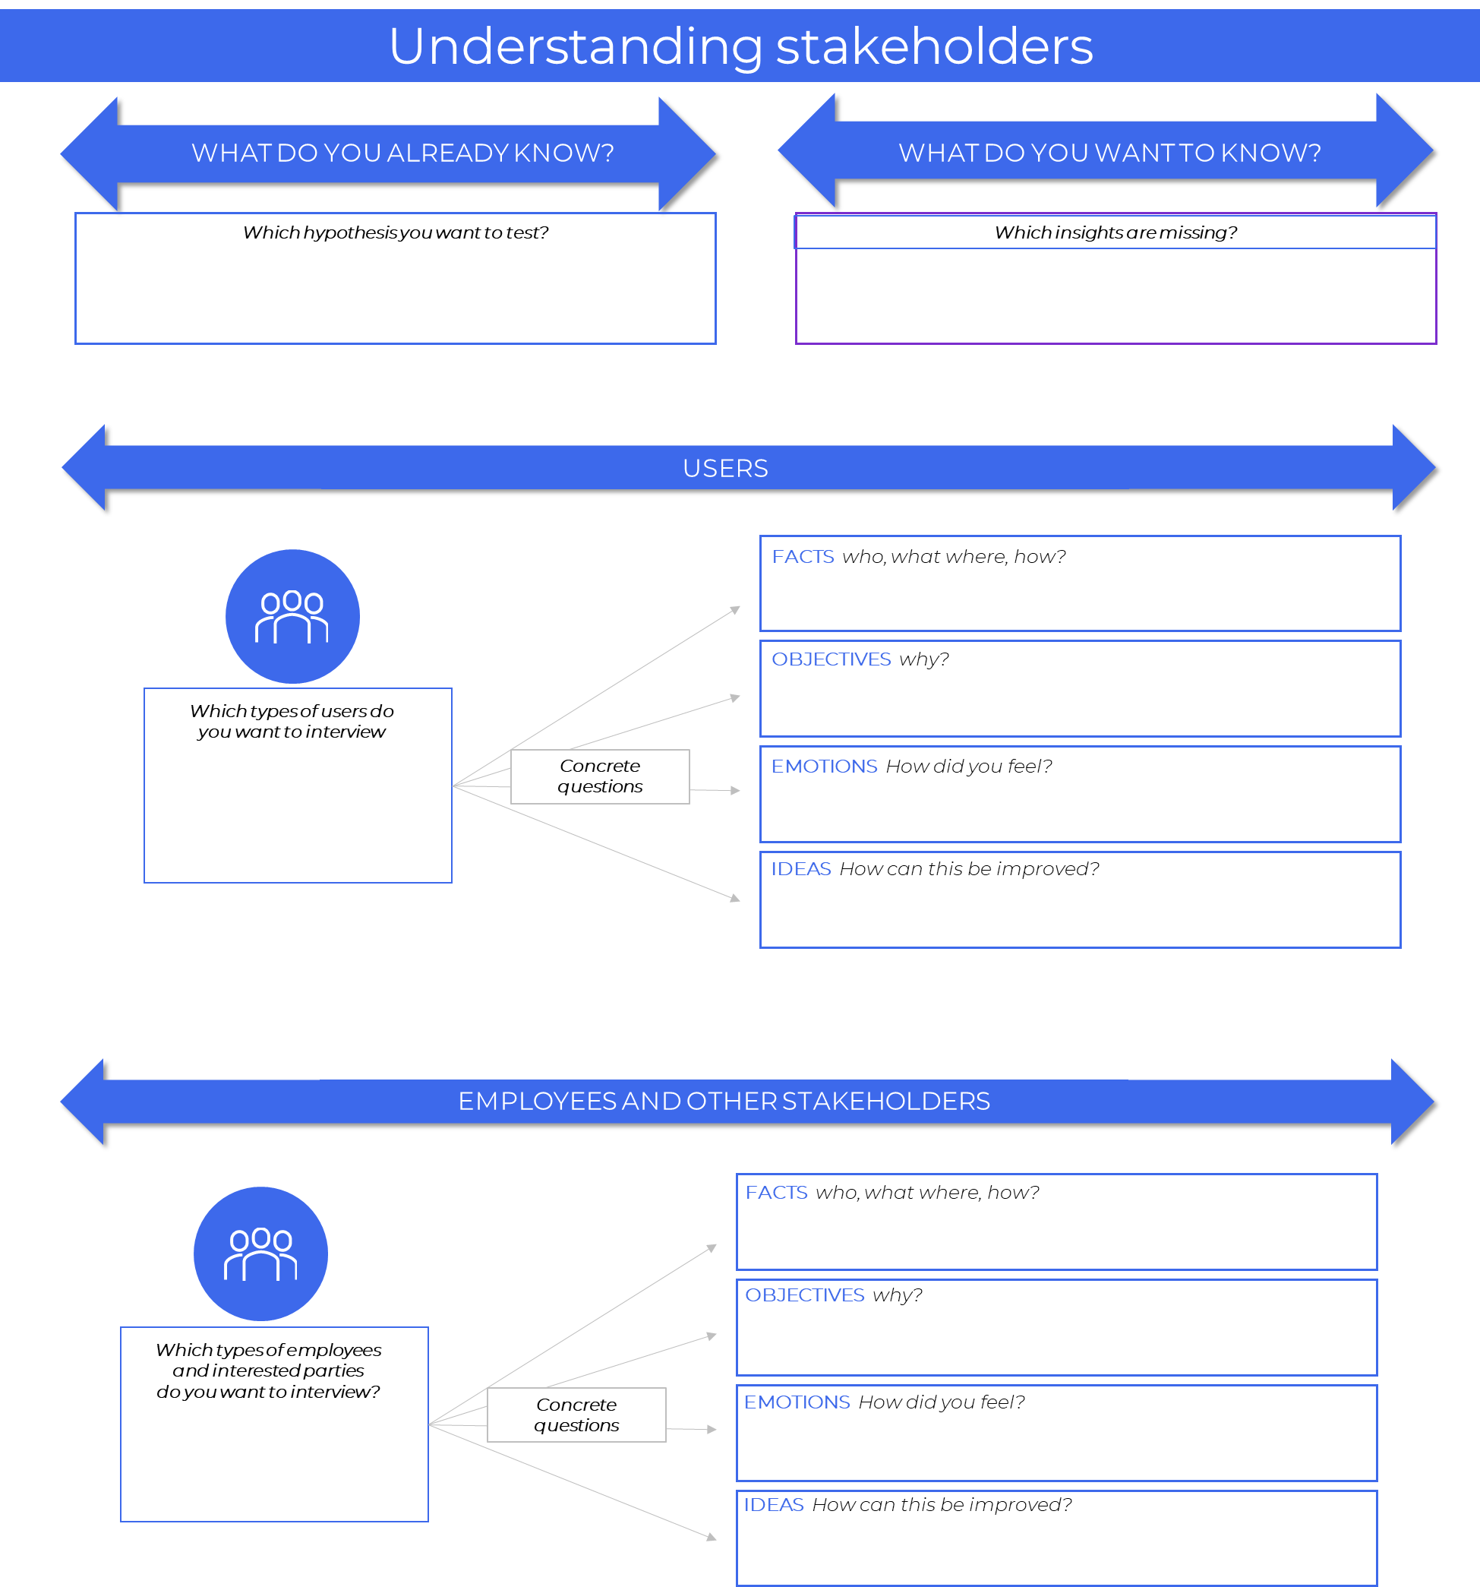
Authorised Use ONLY. Requires a current paid up membership to www.codesign4all.com | Tool ID 1D0303 – Understanding Stakeholders | Version 1.0 | Mar’25
Co.Design4All Pty Ltd
All Rights Reserved.
hello@codesign4all.com www.codesign4all.com

Slide 3
Understanding stakeholders
WHAT DO YOU ALREADY KNOW?
WHAT DO YOU WANT TO KNOW?
Which hypothesis you want to test?
Which insights are missing?
USERS
FACTS who, what where, how?
OBJECTIVES why?
Which types of users do you want to interview
Concrete questions
EMOTIONS How did you feel?
IDEAS How can this be improved?
EMPLOYEES AND OTHER STAKEHOLDERS
FACTS who, what where, how?
OBJECTIVES why?
Which types of employees
and interested parties
do you want to interview?
Concrete questions
EMOTIONS How did you feel?
IDEAS How can this be improved?
Version 1

