Slide 1


Authorised Use ONLY. Requires a current paid up membership to www.codesign4all.com | Tool ID 2D0702 – Rock, Paper, Scissors | Version 1.0 | Mar’25
PHASE | STAGE
2 – DESIGN | 7 - Co-design Sensitizing
TOOL NAME: (ID# 2D0702) | Rock Paper Scissors
About this tool: | This is a warmup activity to get people to know each other and to develop energy in the room.
Tool Citation: | https://www.sessionlab.com/methods/rock-paper-scissors-tournament,
Copyright Notice and Disclaimer:
This material is Copyright to Co.Design4All Pty Ltd 2025. All rights reserved. The material in this site is intended for general informational use and is not intended to constitute advice. Co.Design4All accepts no responsibility should any damages be caused to a person or organisation as a result of the use that is made of information provided. Co.Design4All assumes no responsibility or liability for any errors or omissions in the content of this site, including where original materials attributed to other copyright owners are presented within the tools and templates made available. All rights to third-party content cited in a tool or template remain with the copyright owner and no infringement of their rights is intended. The information contained in this site and on the Co.Design4All tools and templates are provided on an “as is” and “as available” basis with no guarantees of completeness, accuracy, usefulness or timeliness. Co.Design4All expressly disclaims all conditions, representations and warranties – whether express, implied, statutory or otherwise, including but not limited to, any implied warranty of merchantability, fitness for a particular purpose, or non-infringement of third-party rights. No advice or information, whether oral or written, obtained by a user from this site will create any warranty not expressly stated herein. This disclaimer also applies to any damage or injury caused by any failure of performance, error, omission, interruption, deletion or delay in operation or transmission, unauthorised access or use of information under any cause of action.
Co.Design4All Pty Ltd
All Rights Reserved.
hello@codesign4all.com www.codesign4all.com

Slide 2
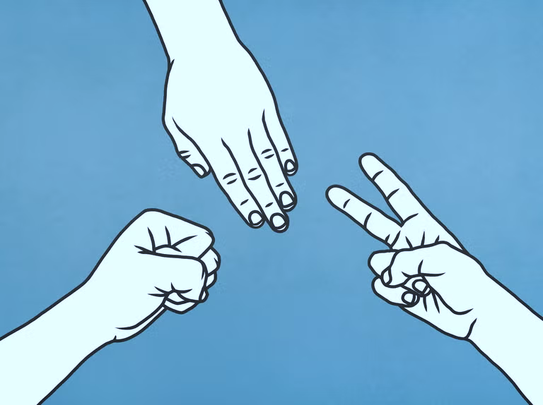
Authorised Use ONLY. Requires a current paid up membership to www.codesign4all.com | Tool ID 2D0702 – Rock, Paper, Scissors | Version 1.0 | Mar’25
Rock Paper Scissors
Rock, Paper, Scissors (Tournament):
Create energy in the room with this warm-up task. In this task people in the room will play the “Rock, Paper, Scissor” game - with a twist: the losing players become the fan of the winners as the winner advances to the next round. This goes on until a final showdown with two large cheering crowds!
It can be played with adults of all levels as well as kids and it always works!
Goal:
Create energy and connections between people in the room.
Instructions:
Invite each person in the room to find a partner
Invite pairs to play "Rock, Paper, Scissors" against each other until the first win.
The winner has to find a new opponent. The losing player becomes a fan of the winner.
The winner plays against the new opponent, while their fan cheers for them.
The winner of the second game searches for a new opponent, while the losing team joins their fan base.
Repeat until there are only two opponents with the rest of the room cheering for them. The last two have to play until one player has won in a best of 3 game.
Rock, Paper, Scissors Rules
The basic rules of "Rock, Paper, Scissors" are the following.
The players count to 3. On 3 they form one out of 3 symbols with their hands:
1) "Rock" – the fist
2) "Paper" – the straight hand
3) "Scissors" – index and middle-finger pointing out
Each symbol wins and loses against one other symbol:
"Rock" blunts the "Scissors".
"Scissors" cut "Paper".
"Paper" wraps the "Rock"
Co.Design4All Pty Ltd
All Rights Reserved.
hello@codesign4all.com www.codesign4all.com

