Slide 1


Authorised Use ONLY. Requires a current paid up membership to www.codesign4all.com | Tool ID 2D0812 – Patient Journey Mapping | Version 1.0 | Mar’25
PHASE | STAGE
2 – DESIGN | 8 - Co-design Facilitation
TOOL NAME: (ID# 2D0812) | Patient Journey Mapping
About this tool: | This is a tool that can be used to better understand the impact of a service on patients and the barriers and enablers to making that service more accessible, appealing or efficient to deliver.
Tool Citation: | https://keyreply.com/blog/patient-journey-mapping/
Copyright Notice and Disclaimer:
This material is Copyright to Co.Design4All Pty Ltd 2025. All rights reserved. The material in this site is intended for general informational use and is not intended to constitute advice. Co.Design4All accepts no responsibility should any damages be caused to a person or organisation as a result of the use that is made of information provided. Co.Design4All assumes no responsibility or liability for any errors or omissions in the content of this site, including where original materials attributed to other copyright owners are presented within the tools and templates made available. All rights to third-party content cited in a tool or template remain with the copyright owner and no infringement of their rights is intended. The information contained in this site and on the Co.Design4All tools and templates are provided on an “as is” and “as available” basis with no guarantees of completeness, accuracy, usefulness or timeliness. Co.Design4All expressly disclaims all conditions, representations and warranties – whether express, implied, statutory or otherwise, including but not limited to, any implied warranty of merchantability, fitness for a particular purpose, or non-infringement of third-party rights. No advice or information, whether oral or written, obtained by a user from this site will create any warranty not expressly stated herein. This disclaimer also applies to any damage or injury caused by any failure of performance, error, omission, interruption, deletion or delay in operation or transmission, unauthorised access or use of information under any cause of action.
Co.Design4All Pty Ltd
All Rights Reserved.
hello@codesign4all.com www.codesign4all.com

Slide 2
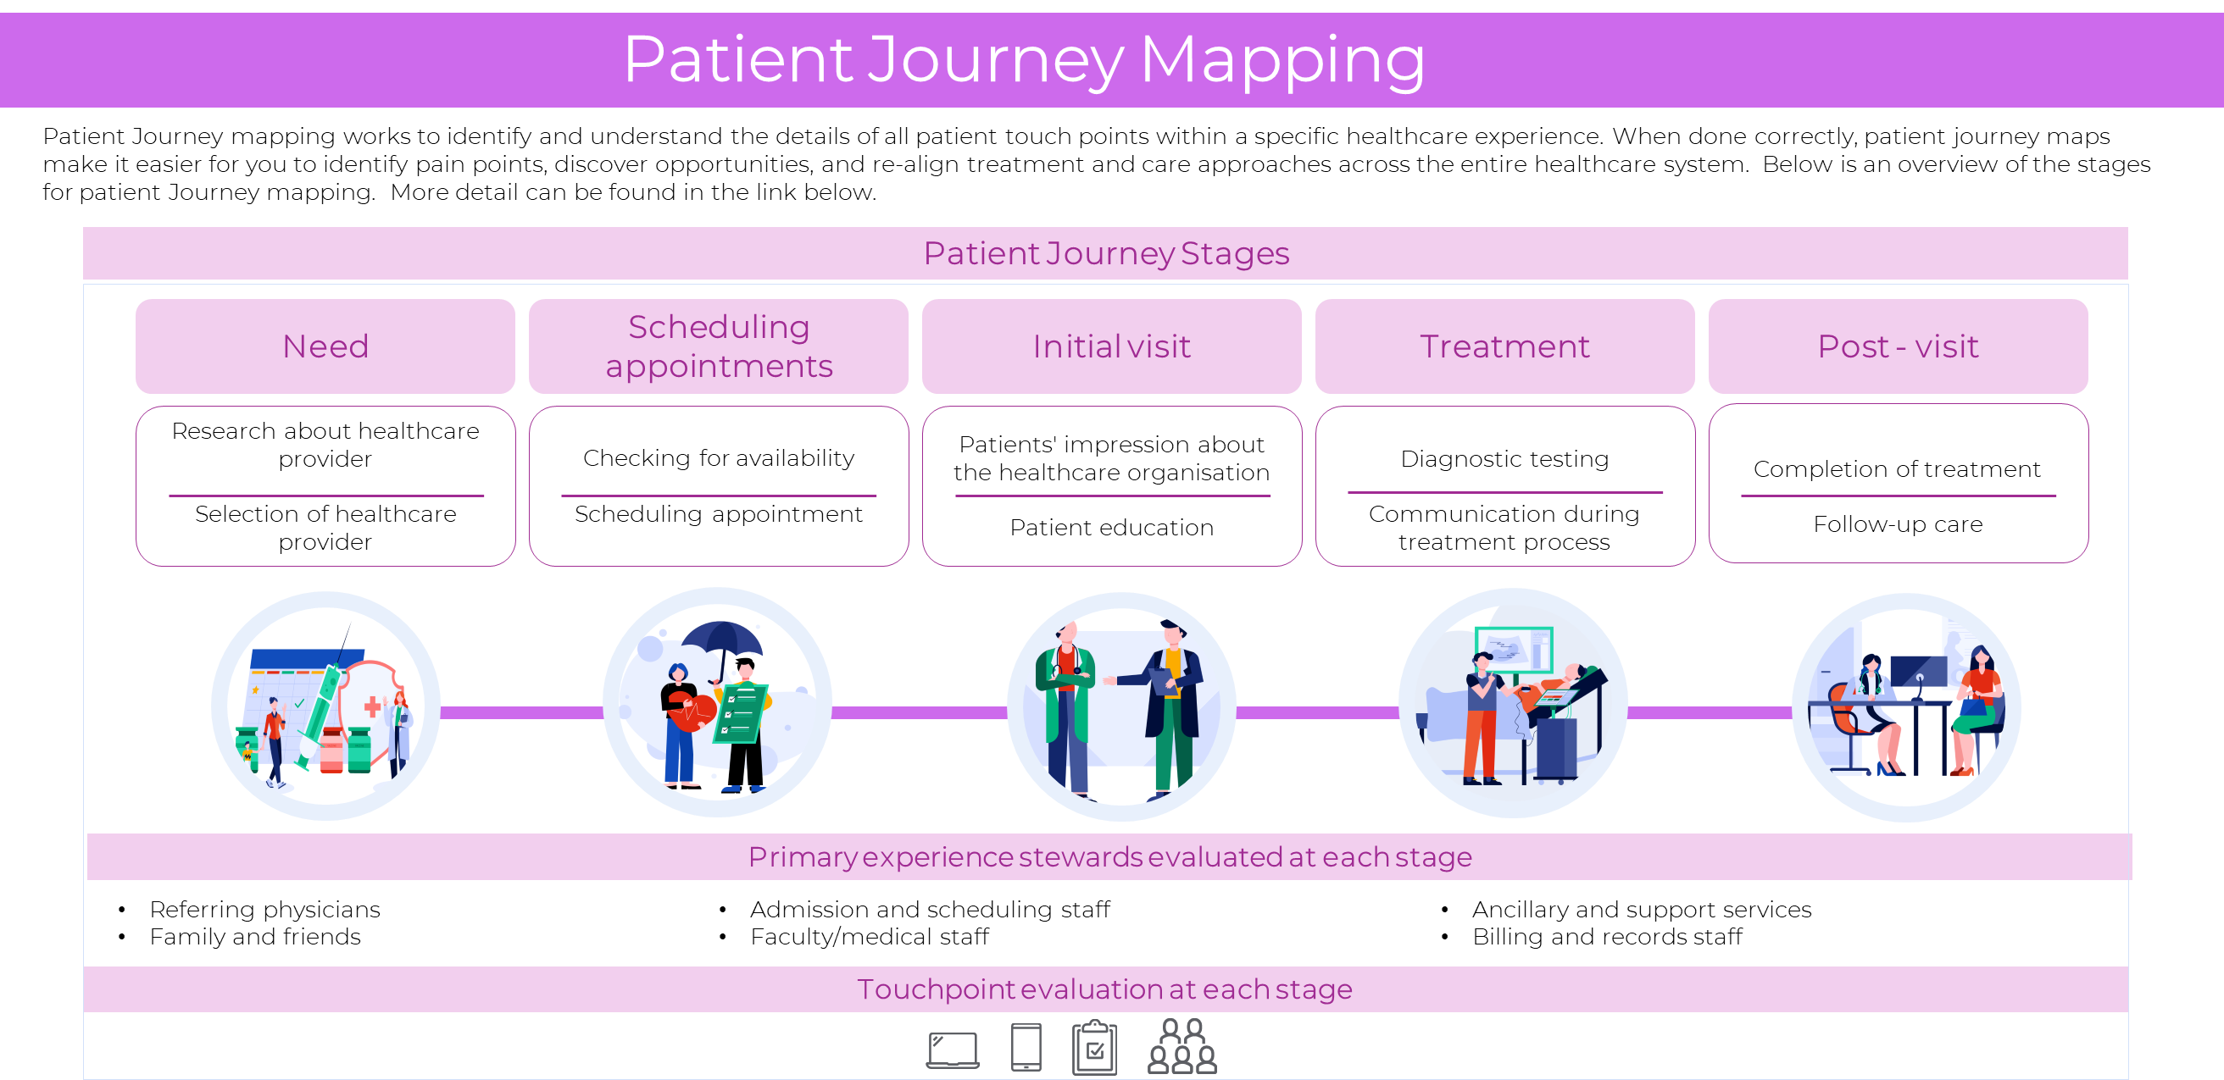
Authorised Use ONLY. Requires a current paid up membership to www.codesign4all.com | Tool ID 2D0812 – Patient Journey Mapping | Version 1.0 | Mar’25
Co.Design4All Pty Ltd
All Rights Reserved.
hello@codesign4all.com www.codesign4all.com

