Slide 1


Authorised Use ONLY. Requires a current paid up membership to www.codesign4all.com | Tool ID 3D1012 – PICK Chart | Version 1.0 | Mar’25
PHASE | STAGE
3 – DECIDE | 10 - Analysis
TOOL NAME: (ID# 3D1012) | PICK Chart
About this tool: | This tool supports decision making around the priority ideas to pursue. It brings to light the most impactful ideas which require the least amount of effort. It is also called Ease and Impact Analysis.
Tool Citation: | https://www.designkit.org/resources/1.html
Copyright Notice and Disclaimer:
This material is Copyright to Co.Design4All Pty Ltd 2025. All rights reserved. The material in this site is intended for general informational use and is not intended to constitute advice. Co.Design4All accepts no responsibility should any damages be caused to a person or organisation as a result of the use that is made of information provided. Co.Design4All assumes no responsibility or liability for any errors or omissions in the content of this site, including where original materials attributed to other copyright owners are presented within the tools and templates made available. All rights to third-party content cited in a tool or template remain with the copyright owner and no infringement of their rights is intended. The information contained in this site and on the Co.Design4All tools and templates are provided on an “as is” and “as available” basis with no guarantees of completeness, accuracy, usefulness or timeliness. Co.Design4All expressly disclaims all conditions, representations and warranties – whether express, implied, statutory or otherwise, including but not limited to, any implied warranty of merchantability, fitness for a particular purpose, or non-infringement of third-party rights. No advice or information, whether oral or written, obtained by a user from this site will create any warranty not expressly stated herein. This disclaimer also applies to any damage or injury caused by any failure of performance, error, omission, interruption, deletion or delay in operation or transmission, unauthorised access or use of information under any cause of action.
Co.Design4All Pty Ltd
All Rights Reserved.
hello@codesign4all.com www.codesign4all.com

Slide 2
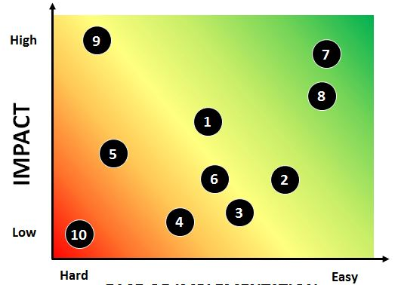
Authorised Use ONLY. Requires a current paid up membership to www.codesign4all.com | Tool ID 3D1012 – PICK Chart | Version 1.0 | Mar’25
PICK Chart
As the name suggests the purpose of a PICK Chart is to rate all of the ideas the process has identified in a way where biggest bang for buck is very evident to the group.
In order to rate impact, you might want to suggest some evaluation criteria related to the project and score each idea against those criteria before using that data to summarise impact. This can add more rigour to the analysis. It is especially useful where large sums of money or big change is involved and where the impact is related to changing an individual life. If something is easy but makes very little difference to length of life or disease state it might not be particularly effective.
To assess the ease of implementation things like time involved, costs, the need to develop new systems or technology, to change legislation, to acquire new skills or pool funds in new ways could be the sorts of criteria used.
Once you have a sense of what will feed into your impact and ease ratings you can then simply plot each project on a 2 x two matrix like the one to the right.
Co.Design4All Pty Ltd
All Rights Reserved.
hello@codesign4all.com www.codesign4all.com

